Slide 1

بسم الله الرحمن الرحيم
«وما أوتيتم من العلم الا قليلا»

Slide 2
By
Dr. Mohammad Gamal Abdalrahman
Lecturer of Chest Diseases
Faculty of Medicine
Assiut University
Respiratory Failure

Slide 3
The respiratory system supplies the body with adequate oxygen for aerobic metabolism and simultaneously removes its major metabolic waste product carbon dioxide.

Slide 4
Definition of Respiratory Failure
Respiratory failure is a syndrome in which the respiratory system fails in one or both of its gas exchange functions: oxygenation and carbon dioxide elimination, due to dysfunction of one or more of the essential components of the respiratory system

Slide 5
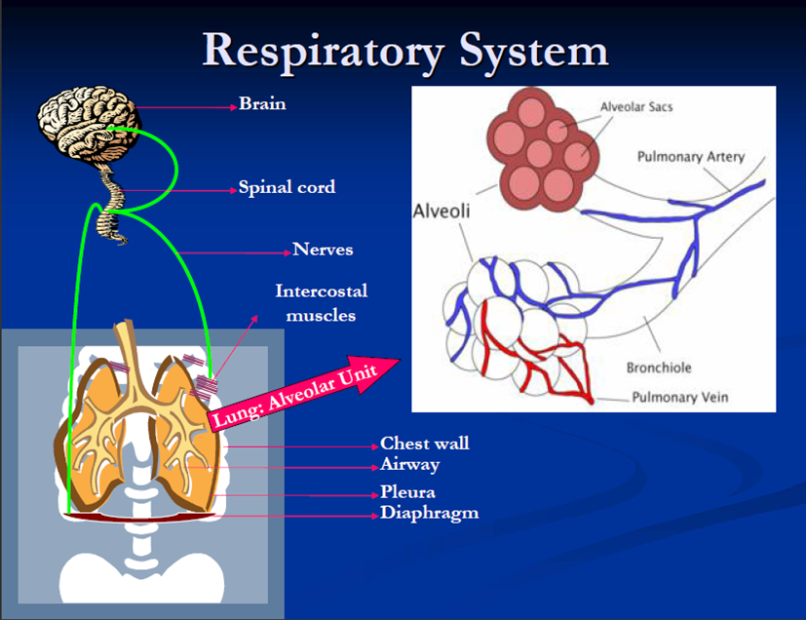

Slide 6
PO2 < 60 mmHg
At sea Level
At rest
On room air
Rule out other causes (Congenital cyanotic heart disease and abnormal types of hemoglobin)

Slide 7
Types of respiratory failure
Type I respiratory failure (Hypoxemic type): is characterized by an arterial oxygen tension (PaO2) lower than 60 mm Hg with a normal or low arterial carbon dioxide tension (PaCO2). This is the most common form of respiratory failure.
Type II respiratory failure (Hypercapnic type): characterized by PaO2 lower than 60 mm Hg with increased PaCO2.

Slide 8
Type 1:
PaO2<60 mm Hg
PaCo2≤35-45 mmHg
Type 2:
PaO2<60 mm Hg
PaCo2>50 mmHg

Slide 9
Handerson Hasselbach Equation
PH= pKa+HCO3/PaCo2
PH= HCO3/PaCo2
↑PH= ↑ HCO3
↓PH= ↓ HCO3
↑ PH= ↓ PaCo2
↓PH= ↑ PaCo2

Slide 10
What is PH?
PH is the negative log of the activity of the hydrogen ion in an aqueous solution.

Slide 11
Type 1:
Acute:
Pao2<60mmHg HCO3 Normal
PaCo2⊆35 mmHg PH > 7.45
Chronic:
Pao2<60mmHg PaCo2⊆35mmHg
HCO3 <22mEq/L PH=7.40-7.45

Slide 12
Type 2:
Acute:
Pao2<60mmHg HCO3 Normal
PaCo2>50 mmHg PH<7.35
Chronic:
Pao2<60mmHg PaCo2 >50 mmHg
HCO3 >26 mEq/L PH=7.35-7.40

Slide 13
Type 1 RF
HCO3 | pCO2 | pO2 | PH
 |  |  |  | Acute
 |  |  |  | Chronic
normal
normal

Slide 14
Type 2 RF
HCO3 | pCO2 | pO2 | PH
 |  |  |  | Acute
 |  |  |  | Chronic
normal
normal

Slide 15
Aetiology
Acute Type 1 RF
Cardiogenic pulmonary edema
Non cardiogenic pulmonary edema
Pneumonia
Pulmonary Embolism
Interstitial Lung Disease
Severe bronchial asthma without diaphragmatic fatigue
Acute milliary TB and lymphagitis tuberculosa reticularis

Slide 16
ChronicType I RF
Fibrosing alveolitis
Other causes of IPF
Chronic allergic alveolitis
Chronic thromboembolic pulmonary hypertension
Chronic pulmonary edema
Lymphangitis carcinomatosis

Slide 17
Acute Type II RF
Upper airway obstruction
Acute severe asthma with diaphragmatic fatigue
Acute CNS disorder
Myathenia gravis
polyneuritis
Acute Exacerbation of COPD

Slide 18
Chronic Type II RF
COPD
Obesity Hypoventilation Syndrome
kyphoscoliosis
Chronic neuromuscular diseases
Progressive respiratory diseases preterminal

Slide 19
Diagnosis
Clinical picture of causative disease
Manifestations of hypoxaemia.
1-Central cyanosis if reduced hemoglobin is >5gram%.
2- Restlessness, irritability,, impaired intellectual functions.
3- Acute severe hypoxaemia may cause convulsions, coma and death.
4- Hyperventilation and tachypnae through stimulation of chemoreceptors

Slide 20
5- Tachycardia, arrythmias, increased COP and dilatation of peripheral vessels
6- Pulmonary vasoconstriction with pulmonary hypertension
7- Secondary polycythaemia with predisposition to DVT and pulmonary embolism

Slide 21
Manifestations of hypercapnia:
1-Drowsines, flapping tremors, coma (CO2 narcosis) and papillodema due to increased CSF formation secondary to cerebral vasodilatation and increased cerebral blood flow.
2-Paradoxical action on peripheral blood vessels: Vasodilatation through direct action and vasoconstriction through sympathetic stimulation and the predominant action is the local one.
3-Tachycardia, sweating and generalized vasodilatation with hypotension.

Slide 22
Investigations
Investigations for the underlying cause
Arterial blood gas analysis (ABG).
Non-invasive methods

Slide 23
Management
Treatment of the underlying cause
Correction of hypoxaemia
Treatment of complications

Slide 24
Complications of RF:
1-Cardiac arrythmias due to severe hypoxaemia and acidaemia secondary to CO2 retention.
2-Pulmonary hypertension and cor pulmonale due to pulmonary vasoconstriction as a result of hypoxaemia and acidaemia.
3-DVT and pulmonary embolism due to polycythaemia secondary to chronic hypoxaemia.
4-Complications of oxygen therapy and mechanical ventilation.

Slide 25
Criteria for acute type 1 respiratory failure include the following except:
1-PH 7.54
2-PaO2 44 mmHg
3-PaCO2 24 mmHg
4-HCO3 36 mEq/L

Slide 26
Criteria for acute type 1 respiratory failure include the following except:
1-PH 7.54
2-PaO2 44 mmHg
3-PaCO2 24 mmHg
4-HCO3 36 mEq/L

Slide 27
Criteria for chronic type 1 respiratory failure include the following except:
1-PH 7.30
2-PaO2 50 mmHg
3-PaCO2 30 mmHg
4-HCO3 16 mEq/L

Slide 28
Criteria for chronic type 1 respiratory failure include the following except:
1-PH 7.30
2-PaO2 50 mmHg
3-PaCO2 30 mmHg
4-HCO3 16 mEq/L

Slide 29
Criteria for chronic type 11 respiratory failure include the following except:
1-PH 7.38
2-PaO2 48 mmHg
3-PaCO2 70mmHg
4-HCO3 15 mEq/L

Slide 30
Criteria for chronic type 11 respiratory failure include the following except:
1-PH 7.38
2-PaO2 48 mmHg
3-PaCO2 70mmHg
4-HCO3 15 mEq/L

Slide 31
Criteria for acute type 11 respiratory failure include the following except:
1-PH 7.60
2-PaO2 40mmHg
3-PaCO2 80mmHg
4-HCO3 25 mEq/L

Slide 32
Criteria for acute type 11 respiratory failure include the following except:
1-PH 7.60
2-PaO2 40mmHg
3-PaCO2 80mmHg
4-HCO3 25 mEq/L

Slide 33
Clinical evidence of hypoxaemia include the following except:
1-Central cyanosis
2-Cardiac arrhythmias
3-Pulmonary hypertension
4-Tachypnae
5-Gastric distension and decreased intestinal motility

Slide 34
Clinical evidence of hypoxaemia include the following except:
1-Central cyanosis
2-Cardiac arrhythmias
3-Pulmonary hypertension
4-Tachypnae
5-Gastric distension and decreased intestinal motility

Slide 35
Clinical manifestations of hypercapnia include the following except:
1-Disturbed conscious level
2-Central cyanosis
3- Gastric distension and decreased intestinal motility
4-Flapping tremors
5-Papilloedema

Slide 36
Clinical manifestations of hypercapnia include the following except:
1-Disturbed conscious level
2-Central cyanosis
3- Gastric distension and decreased intestinal motility
4-Flapping tremors
5-Papilloedema

Slide 37


